Slide 1

Verilookie: A Deepfake and AI-Generated Media Detector
Unveiling the truth in a world of manipulated media.

Slide 2




What is Verilookie?
Verilookie is a web-based application designed to detect deepfakes and AI-generated images and videos, providing users with a robust tool to analyze media files and determine their authenticity.
Image & Video Analysis
Unified Detection Pipeline
Upload media files for deepfake and AI-generation detection.
A multi-layered approach to analysis for more accurate results.
Gamified Learning
Personalized Quizzes
An integrated quiz and reward system to educate users.
AI-powered quizzes that adapt to the user's knowledge level.

Slide 3
Significance in Cybersecurity
The proliferation of deepfakes and AI-generated content poses significant threats. Verilookie directly addresses these challenges:
Combating Misinformation
Preventing Fraud
Helps users verify media authenticity, reducing the spread of fake news and propaganda.
Detects manipulated media used for financial fraud, identity theft, or blackmail.
Protecting Digital Identity
Educating Users
Empowers users to verify if their likeness has been used in a deepfake.
Gamification teaches users to spot manipulated media, building resilience against attacks.

Slide 4
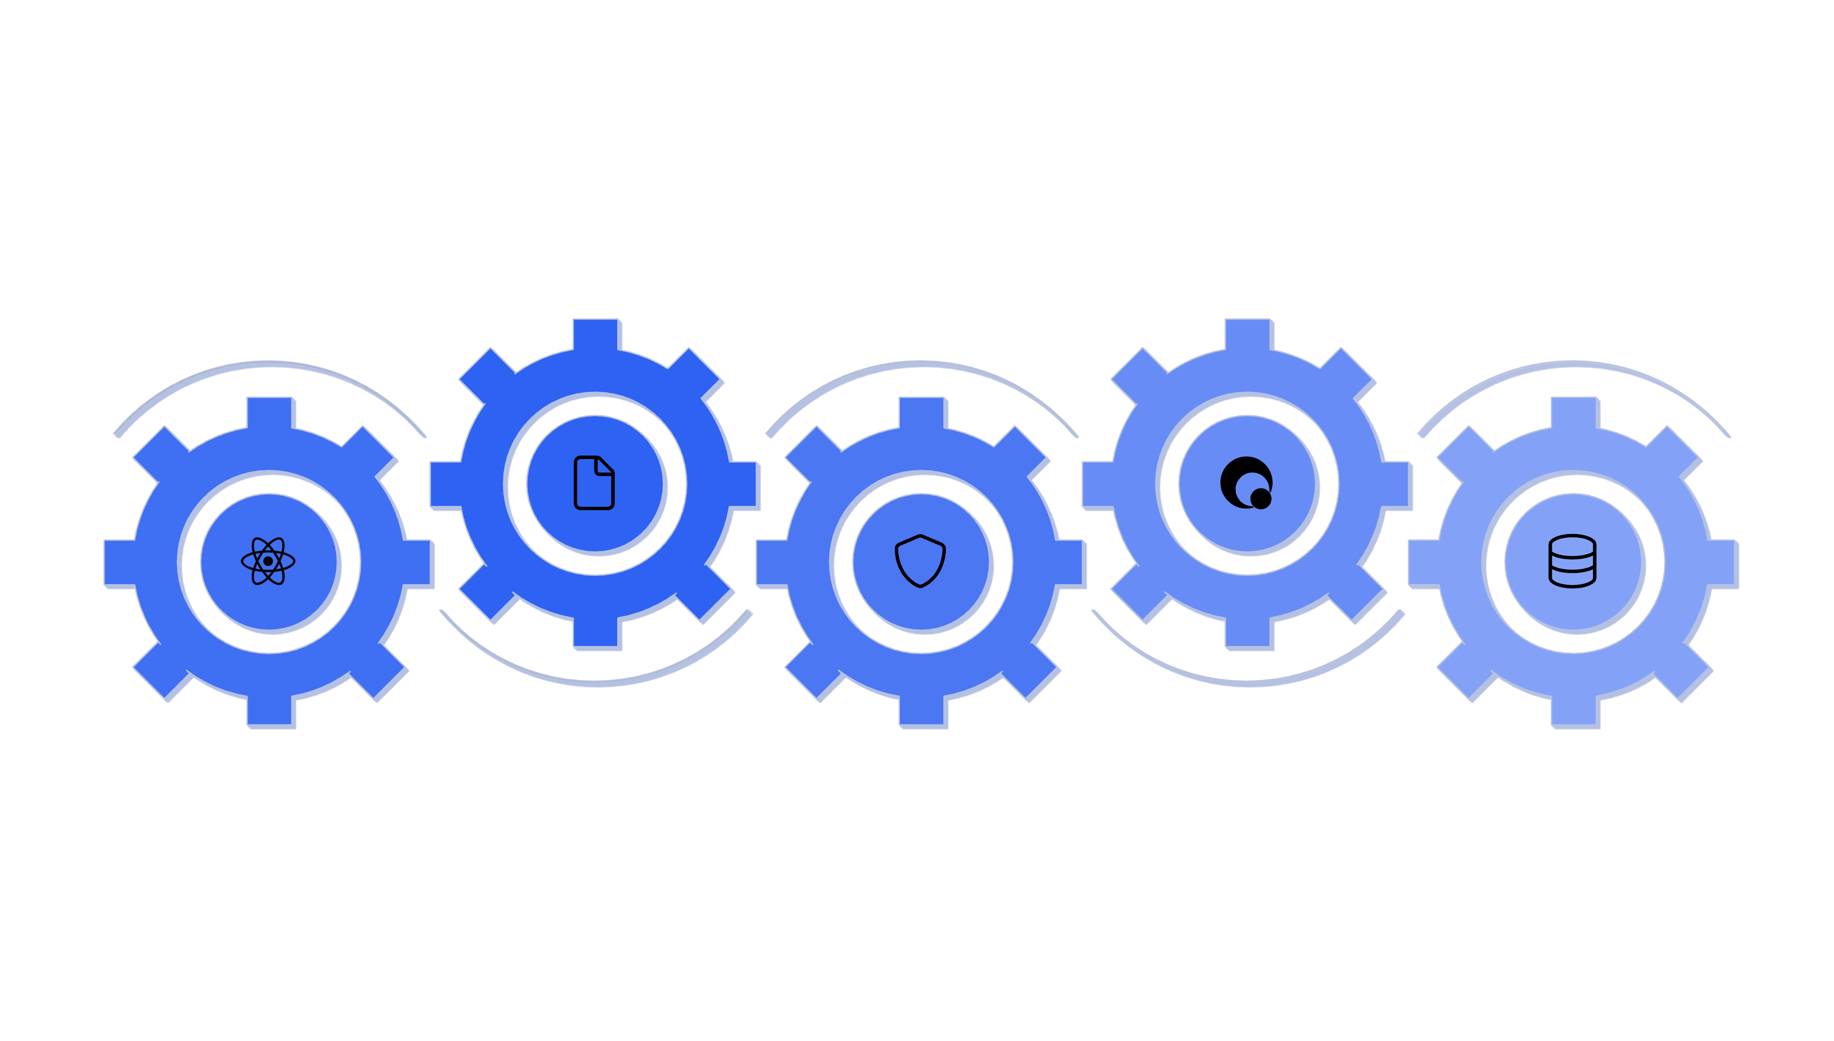





System Architecture (Prototype)
Verilookie is a full-stack web application with a Python backend (FastAPI) and a React frontend, integrating advanced AI/ML models.
FastAPI Backend
Quiz Generator
Handles API, routing, and orchestration
Generates quizzes via Gemini API
React Frontend
Detection Pipeline
AI/ML Models & Storage
User interface for uploads and quizzes
Deepfake, AIGC, unified analysis
ViT, NVIDIA/Gemini APIs, JSON files

Slide 5

Prototype Nature
This project demonstrates core functionalities, with some aspects simplified for the prototype stage:
Data Storage: Uses JSON files instead of a robust database.
User Management: A single user_id is used for demonstration.
Scalability: Not designed for high-traffic, production use.
Future work involves integrating a proper database, full user authentication, and deployment in a scalable cloud environment.

